Slide 2
Coalition for DC Public Schools and Communities C4DC : Six Principles guide our Coalition
Ensure all families have access to high-quality DCPS schools in their neighborhoods – a predictable, matter-of-right path from preschool through high school.
Focus resources on students and communities with the greatest need.
Require coordinated planning between the District of Columbia Public Schools (DCPS) and the Public Charter School Board (PCSB) to build a core system of stable DCPS neighborhood schools with a complementary set of alternative options.
Responsibly manage our financial resources.
Broaden assessment measures to focus on student growth and use multiple measures to assess a quality education.
Ensure families and community members have reliable ways to exercise the right to participate in public education decision making.

Slide 3
High Stakes Accountability Pushed Graduation Rates Up and Then Down
SCANDAL
Source: OSSE Adjusted Cohort Graduation Rates 2011-17, Class of 2018 as of April Update

Slide 4
NAEP scores have improved, but growth has slowed since 2007
Source: M. Levy analysis of NAEP annualized changes in scale score points; NAEP Data Explorer

Slide 5
Teacher turnover is high
DCPS Teachers
DC Charter Teachers
From 2012–17
33%
of teachers in DCPS’s
40 lowest performing
schools left their school
From 2008-17
25%
of teachers new to DCPS leave after
their first year
In 2015-16
66%
of DC charter schools lost 20% or more of their teachers
Source: M. Levy analysis

Slide 6
There are more charter than DCPS schools

Slide 7
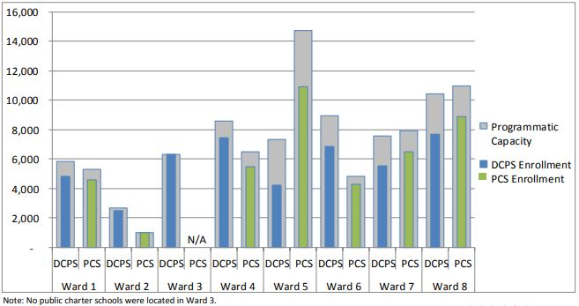
There are an estimated 20,000 excess seats in DCPS and charter schools
Source: DME Citywide Public School Fact Sheet, SY2016-17; pg. 9.

Slide 8
DCPS Offers Far Fewer PK-3 Seats
Source: OSSE audited Enrollments by grade

Slide 9
Per Pupil Spending is up, but still short of ‘13 Adequacy Study Standards
Source: M. Levy analysis of DC Council Budgets FY99-FY16 using constant 2016 $

